Slide 1
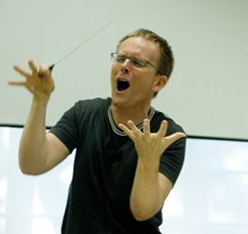
Foundations in conducting
Three sessions
#1 Tuesday July 9, 7-10 pm
#2 Saturday July 13, 6-9 pm
#3 Tuesday July 16, 7-10 pm
This class
Basic techniques: focus on your skills
Much practice in class
Last class: bring your conducting problems
Why study technique?
Show more, talk less!
Notes:
Do demo with changing dynamics, speed, fermatas, articulations

Slide 2
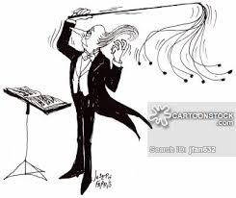
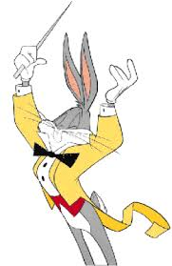
Techniques first class
Posture, arm/hand positions
4- and 3-beat patterns
Preparatory gestures
Articulations: legato, staccato, etc.
2- and 1-beat patterns
Dynamic changes gradual: right hand & left hand
Dynamic changes subito
Fermatas

Slide 3
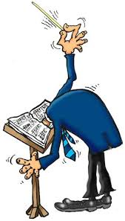
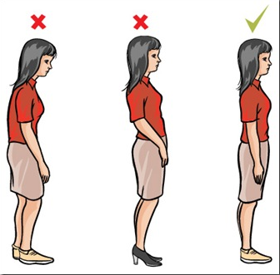
Posture 姿势
Conductor’s posture…a model for good singer’s posture
Tall spine
Shoulders back
Tail tucked in

Slide 4
Arm and hand position

Slide 5
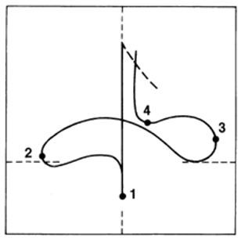
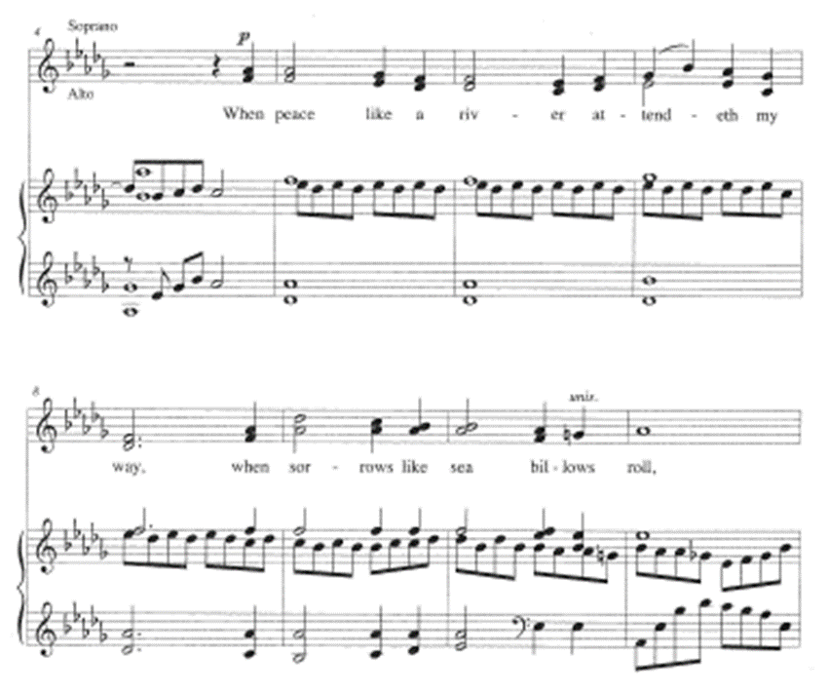
The basic four-beat pattern
Notes:
Also show on white board, including horizontal and vertical planes

Slide 6
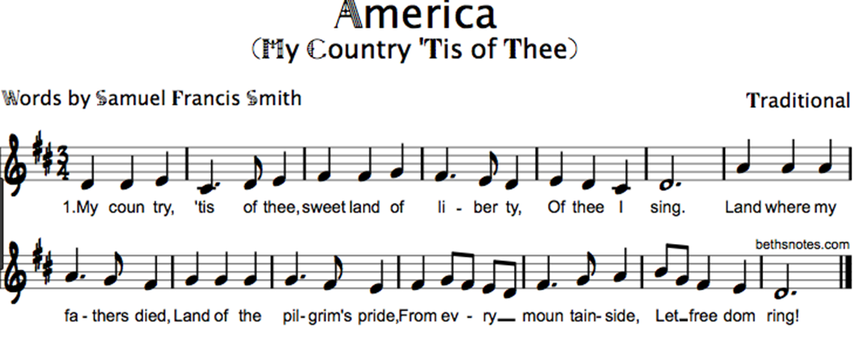
The Three-beat pattern

Slide 7
The Preparatory gesture
It should show…
The start
Volume
Speed
Character: staccato, legato, etc.

Slide 8
Practice preps

Slide 9
More practice preps

Slide 10
Articulation types: legato

Slide 11
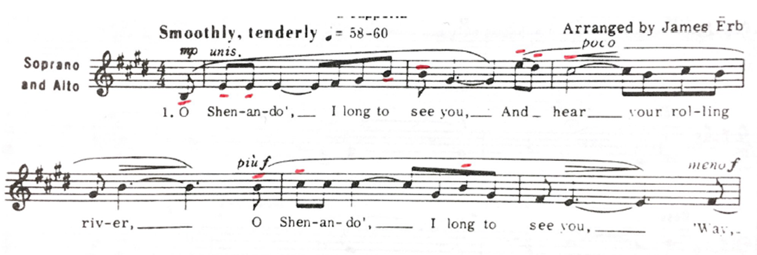
Articulation types: staccato
Articulation types: tenuto

Slide 12
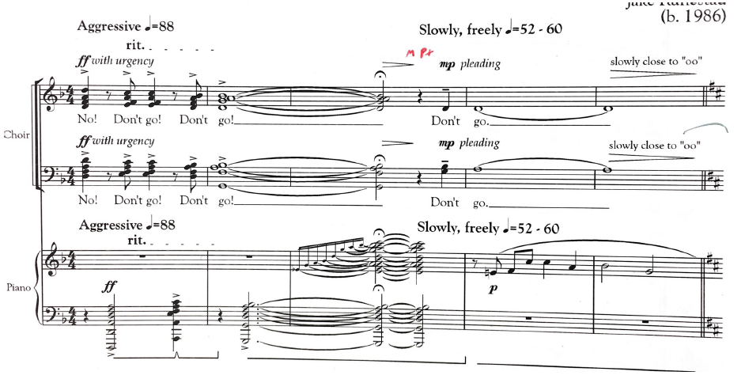
Articulation types: marcato

Slide 13
Two-beat patterns
Staccato:
Legato:
Notes:
Note horizontal plane: important for not getting lost. Marching band gesture

Slide 14
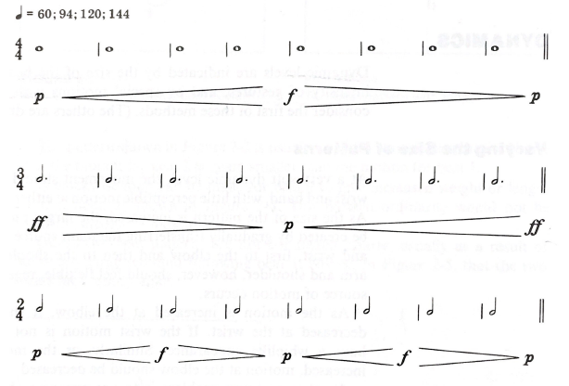
Right-hand dynamics: gradual
Wrist—Elbow—Shoulder

Slide 15
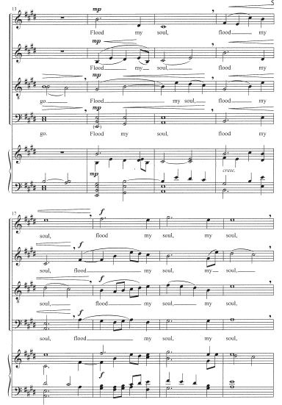

Slide 16
Right-hand dynamics: subito
Notes:
Subito: Where does the change occur?

Slide 17
Left-hand dynamics: gradual

Slide 19
Left-hand dynamics: subito
Notes:
Subito: Where does the change occur?

Slide 20
Fermatas
Three types
Hold + full stop (caesura):
Hold + No Breath and continue:
Hold + cut-off and continue:
(end of cut = start of prep)
Notes:
Also: 1-2-3-4 1-2-3-4 1-2-3-4 1-2-3-4 on white board, with moving fermata

Slide 21
Fermata I: Hold + full stop (caesura)

Slide 22
Fermata II: hold but no break

Slide 23
Fermata III: hold + breath in tempo, no pause
The real challenge!

Slide 24
Topics for next classes
Review!!
Right hand cues
Left hand cues
Compound and divided meters
Tempo changes: gradual and sudden
Principles of rehearsal
Choral tuning
Voice-building exercises
Topics you would like covered
Score study

Slide 25
Your opportunity for input!
Send me your ideas for next classes
What topics or skills
What are conducting problems that you have
Send to tholmchor@gmail.com
Send by Thursday!

